Slide 1
MODULE III
Image Enhancement in Spatial and Frequency Domain

Slide 2
Image enhancement
Image enhancement in image processing refers to techniques used to improve the quality or visual appearance of an image.
The goal is to make certain features of the image more noticeable or more interpretable.
These enhancements can be achieved through various methods, depending on the nature of the image and the desired outcome.

Slide 3
These techniques can be used individually or in combination, depending on the desired enhancement effect.
The choice of technique often depends on the type of image (grayscale, color, noisy, etc.), the specific features to be enhanced (edges, textures, contrast), and the context in which the image will be used (e.g., medical imaging, satellite imagery, or general photography).

Slide 4
Point Operations
Point operations in image processing are techniques where the output pixel value at any given location in the image depends only on the input pixel value at the same location.
These operations are called "point operations" because each pixel is processed independently, without considering its neighbors.
The key idea is that the transformation is applied on a pixel-by-pixel basis, using a mathematical operation or function.

Slide 5
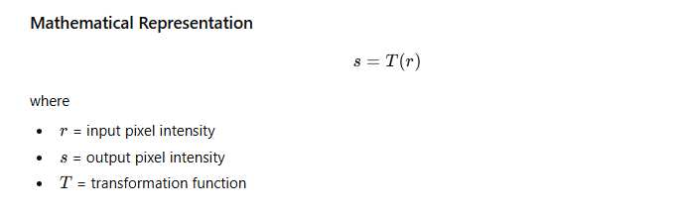

Slide 6
Types of Point Operations
Clipping and Thresholding
Digital Negative
Intensity Level Slicing
Bit Extraction
Range Compression

Slide 7
Clipping and Thresholding

Slide 8
Clipping
Clipping in image processing refers to the process of restricting or limiting the pixel values of an image within a specified range.
Any pixel value that exceeds the upper or lower limit of the range is "clipped" to that limit.
Clipping is often used to adjust the contrast, handle outliers, or ensure that pixel values remain within a valid range for display or further processing.

Slide 9
Clipping is mainly used to control the dynamic range of pixel values and to eliminate unwanted extreme intensity values that may degrade image quality.
Clipping is the process of limiting pixel intensity values such that:
Pixel values below a minimum threshold are set to that minimum value.
Pixel values above a maximum threshold are set to that maximum value.
Pixel values within the range remain unchanged.

Slide 10
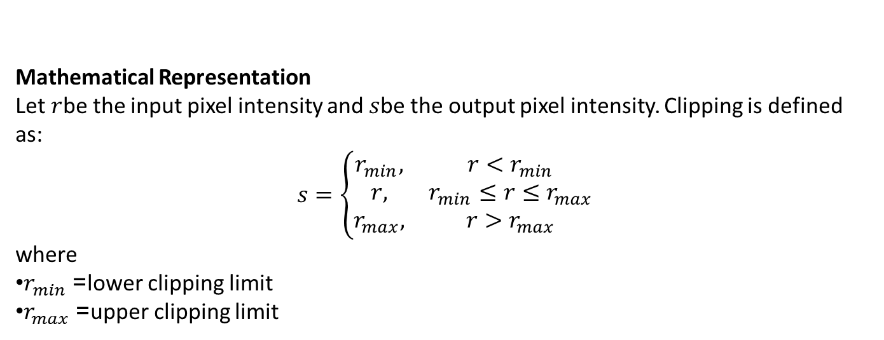
Mathematical Representation
Let $r$be the input pixel intensity and $s$be the output pixel intensity. Clipping is defined as:
$$s=\left\{\begin{matrix}r_{min}, & r<r_{min} \\ r, & r_{min}≤r≤r_{max} \\ r_{max}, & r>r_{max}\end{matrix}\right.$$
where
$r_{min}$= lower clipping limit
$r_{max}$= upper clipping limit

Slide 11
Working Principle
The input image is scanned pixel by pixel.
Each pixel value is compared with the predefined minimum and maximum limits.
If the pixel value lies outside the range, it is replaced by the nearest boundary value.
The processed pixels together form the clipped output image.

Slide 12
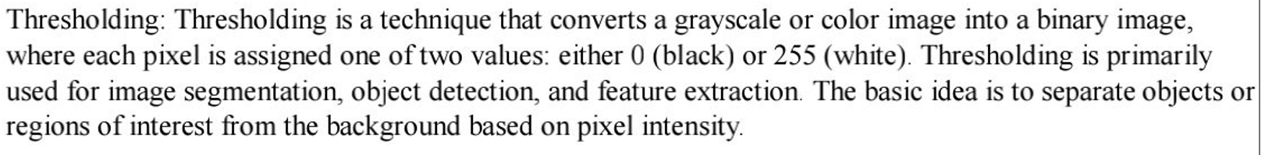
THRESHOLDING

Slide 13
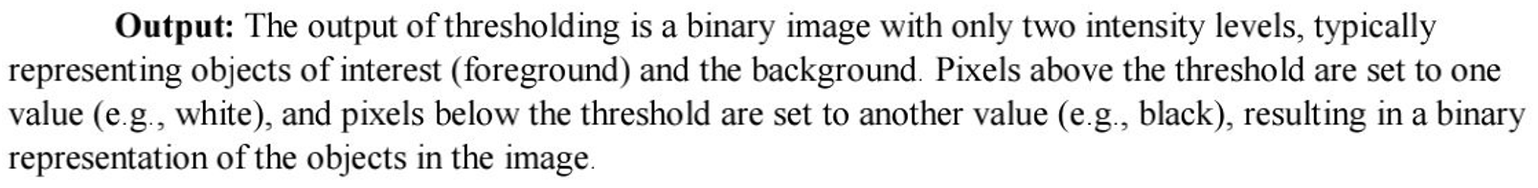

Slide 14
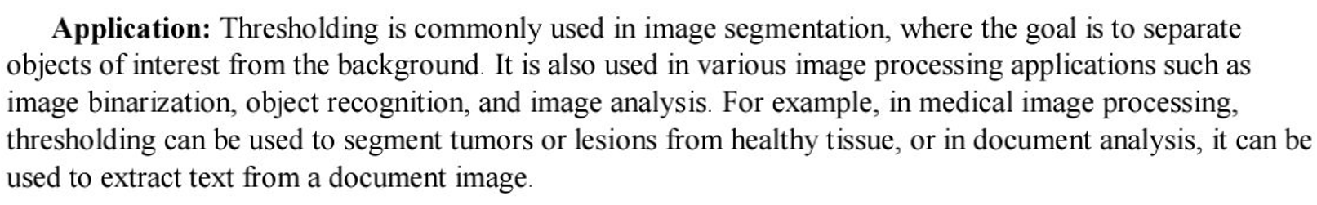
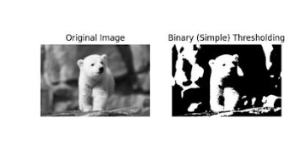

Slide 15
DIGITAL NEGATIVE
A digital negative is a fundamental point operation in digital image processing that transforms an image by reversing its gray levels.
This operation produces an effect similar to photographic negatives, where bright areas become dark and dark areas become bright.
Since each output pixel depends only on the corresponding input pixel, digital negative is classified as a point processing technique.
Digital negative is an image transformation in which the gray level of each pixel is replaced by its complement with respect to the maximum gray level of the image.

Slide 16
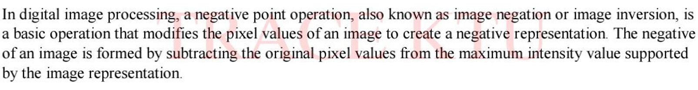

Slide 17
Applications
Medical imaging (X-ray images)
Photographic image enhancement
Satellite and remote sensing images
Enhancing white or gray details on dark backgrounds

Slide 18
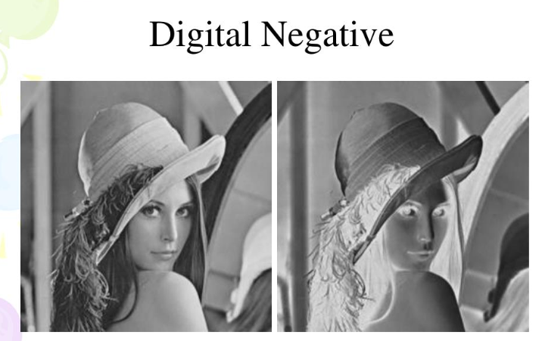

Slide 19
INTENSITY LEVEL SLICING
Intensity level slicing is an important point operation in digital image processing used to highlight a specific range of gray levels in an image.
This technique emphasizes certain features of interest while suppressing or reducing the importance of other intensity values.

Slide 20
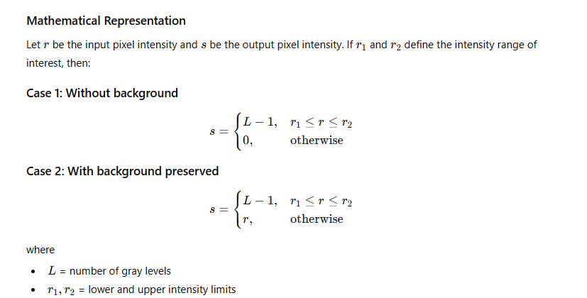

Slide 21
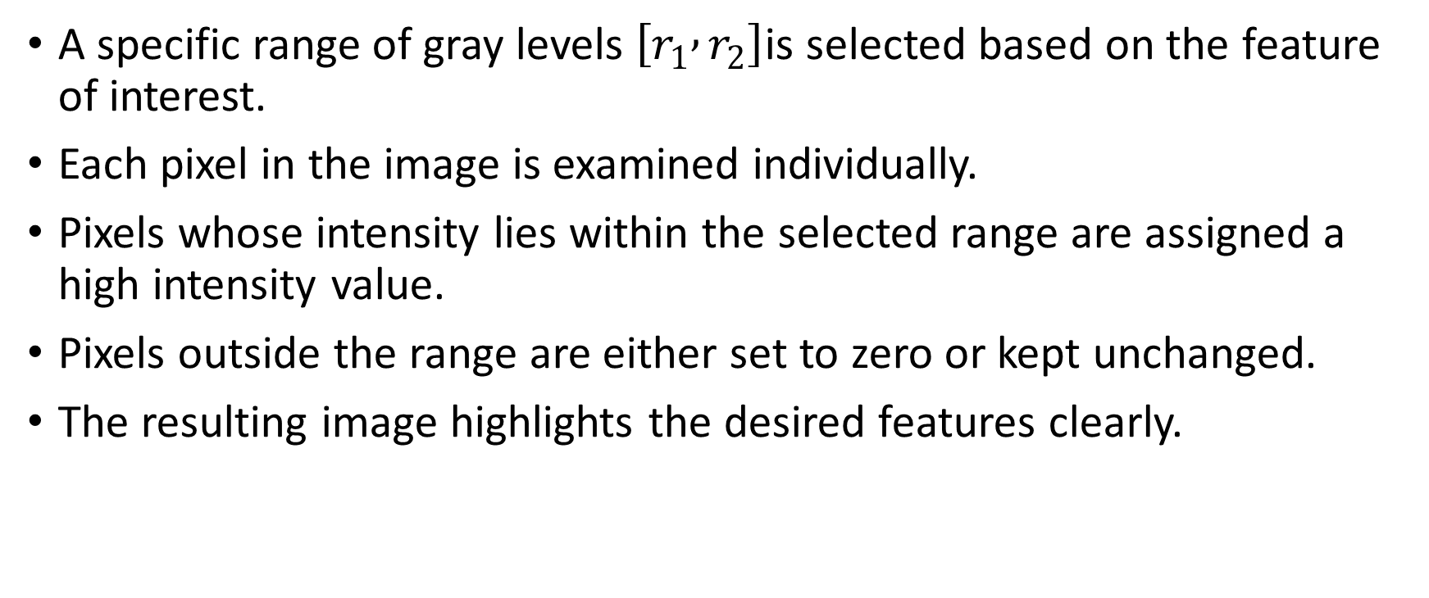
Working Principle
A specific range of gray levels $\left[r_{1} , r_{2}\right]$is selected based on the feature of interest.
Each pixel in the image is examined individually.
Pixels whose intensity lies within the selected range are assigned a high intensity value.
Pixels outside the range are either set to zero or kept unchanged.
The resulting image highlights the desired features clearly.

Slide 22
Applications
Medical imaging (highlighting bones or tissues)
Remote sensing (land and water identification)
Industrial inspection
Image analysis and segmentation

Slide 23
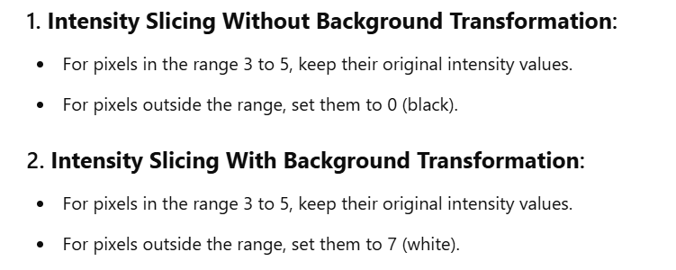

Slide 24
Bit Extraction
Bit extraction is a technique in digital image processing where a gray-scale image is decomposed into its individual bit planes.
Each bit plane represents the contribution of a particular bit (from LSB to MSB) to the image.
Why it is used?
To analyze image details
MSB planes → contain major visual information
LSB planes → contain fine details / noise
Used in image compression, watermarking, and enhancement

Slide 25
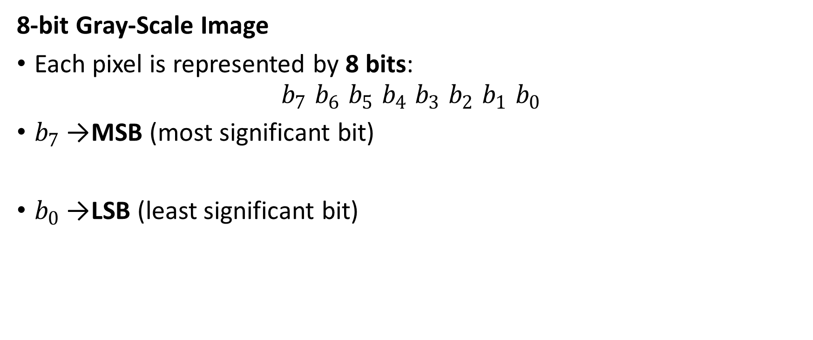
8-bit Gray-Scale Image
Each pixel is represented by 8 bits:
$$b_{7} b_{6} b_{5} b_{4} b_{3} b_{2} b_{1} b_{0}$$
$b_{7}$→ MSB (most significant bit)
$b_{0}$→ LSB (least significant bit)

Slide 26
Range compression
Range compression (also known as dynamic range compression) in image processing refers to a technique used to reduce the range of pixel intensity values in an image.
The goal is to make the darker areas lighter and the lighter areas darker, thereby compressing the dynamic range of pixel values.
This can be particularly useful in images with very high contrast, where details in both the dark and bright regions might be lost because the pixel values are stretched over a large range.
Compression Function: A non-linear function is applied to the pixel values in the image to "compress" the difference between the lowest and highest intensity levels.

Slide 27

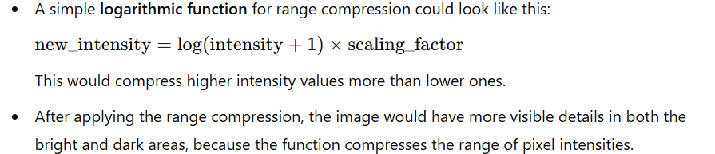
This often involves using a mathematical transformation such as a logarithmic or gamma function.

Slide 28
Range compression is a gray-level transformation used to reduce the dynamic range of an image.
It maps a wide range of input intensities into a smaller range suitable for display.
Logarithmic and power-law transformations are commonly used for range compression, especially in medical and satellite imaging.

Slide 29
Spatial operations
Spatial operations in image processing involve techniques that modify or enhance an image by directly manipulating the pixel values based on their spatial relationship to other pixels.
These operations are performed in the domain of the image, meaning that the calculations are applied to the pixels and their neighborhoods.

Slide 30
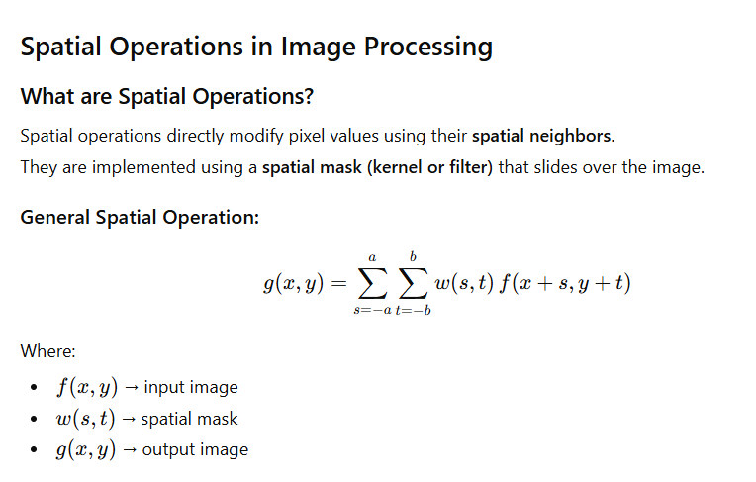

Slide 31
Spatial Convolution and Correlation
Correlation
Correlation is a spatial operation where a mask is slid over the image and multiplied directly with the corresponding neighborhood pixels without flipping the mask.

Slide 32
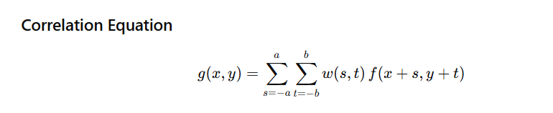
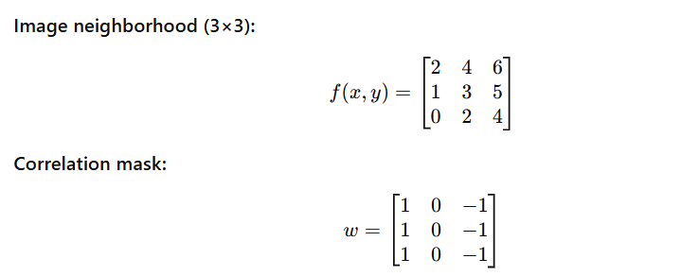
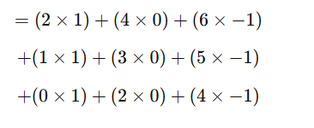


Slide 33
What does the Correlation Value Indicate?
The correlation value indicates how closely the image region matches the given mask (template) at a particular location.

Slide 34
Large Positive Value
Strong similarity between image region and mask
Pattern in the image matches the mask orientation
Indicates presence of a feature (edge, line, texture)
Large Negative Value
Strong match, but in the opposite direction
Indicates an edge with reversed contrast
Very important in edge detection
Value Near Zero
Weak or no match
Region is uniform or does not contain the feature
No significant structure detected

Slide 35
Applications
Template matching
Edge detection
Feature extraction
Image registration
Motion detection
Object recognition
Pattern recognition
Texture analysis
Video surveillance
Medical image analysis

Slide 36
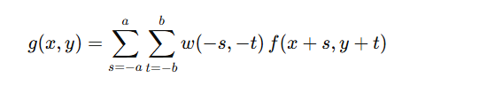
Convolution
It is a spatial operation similar to correlation, but the mask is rotated by 180° before being applied to the image.

Slide 37
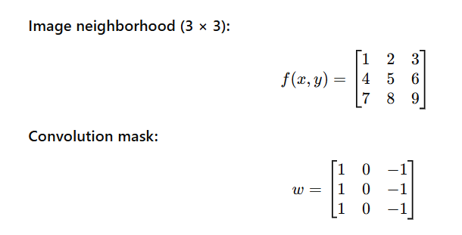
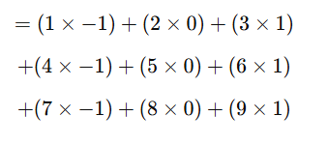
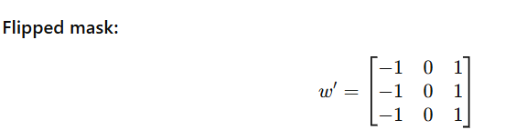
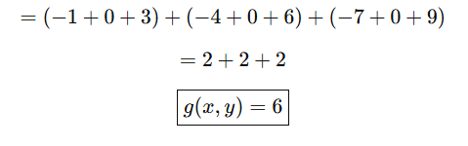
Rotate the Mask by 180°= horizontal flip + vertical flip

Slide 38
The convolution value tells how strongly the detector responds at that pixel.
Large positive value → Strong presence of the feature the filter is designed to detect (edge, line, brightness change, etc.
Large negative value → Strong presence of the same feature but in the opposite direction
Value near zero → No significant feature (smooth or uniform area)

Slide 39
Application
Image smoothing (noise reduction)
Image sharpening
Edge detection
Feature extraction
Image enhancement
Blur effects
Image restoration
Medical image processing
Satellite and remote sensing images
Computer vision preprocessing

Slide 40
Aspect | Correlation | Convolution
Mask flipping | Mask is not flipped | Mask is flipped by 180°
Mathematical operation | Direct matching | Linear system operation
Kernel orientation | Same as given | Reversed orientation
Main purpose | Measure similarity / pattern matching | Filtering / feature enhancement
System theory basis | No | Yes (linear, shift-invariant systems)
Use in image processing | Template matching, feature detection | Smoothing, sharpening, edge detection
Output value meaning | Degree of similarity | Filter response / new pixel value
Symmetric mask result | Same as convolution | Same as correlation
Computational complexity | Slightly simpler | Slightly more rigorous

Slide 41
Spatial Averaging
Spatial averaging is a smoothing technique used to reduce noise by replacing each pixel value with the average of its neighboring pixels.
It is a linear spatial filter.

Slide 42
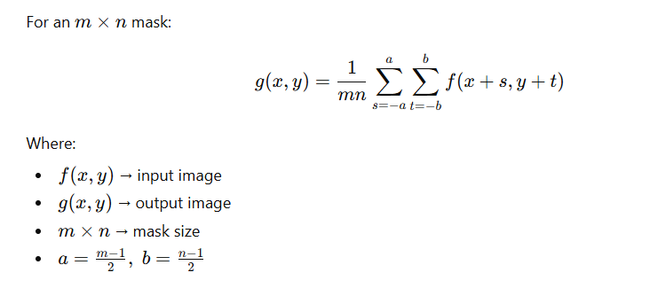
Mathematical Representation

Slide 43
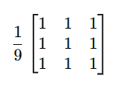
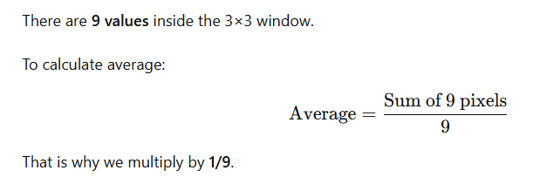
Example (3×3 Mean Filter Mask)
Each pixel becomes the average of 9 pixels.

Slide 44
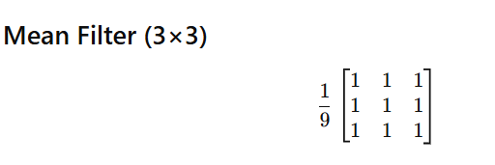

Given 5×5 Image
$$\left[\begin{matrix}1 & 2 & 3 & 4 & 5 \\ 2 & 3 & 4 & 5 & 6 \\ 3 & 4 & 20 & 6 & 7 \\ 4 & 5 & 6 & 7 & 8 \\ 5 & 6 & 7 & 8 & 9\end{matrix}\right]$$

Slide 45
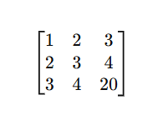
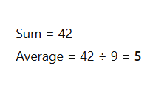
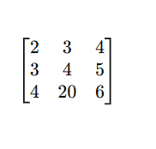
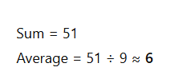
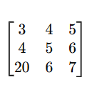


Final Output (3×3)
$$\left[\begin{matrix}5 & 6 & 7 \\ 6 & 7 & 8 \\ 7 & 8 & 9\end{matrix}\right]$$

Slide 46
Applications
Noise reduction
Preprocessing before segmentation
Medical image smoothing
Spatial averaging = Replace pixel with average of neighborhood
Result = Smooth image

Slide 47
Directional Smoothing
Directional smoothing, also known as anisotropic smoothing or directional filtering.
It is a technique used in image processing to selectively smooth an image along specific directions while preserving edge information in other directions.
Directional smoothing takes into account the local image structure and applies smoothing along the dominant edges or structures in the image.
This operation is particularly useful for preserving important features while reducing noise or unwanted variations.

Slide 48
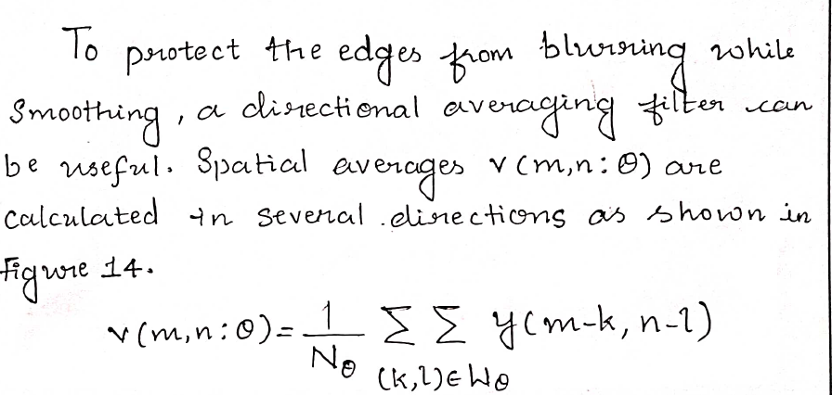
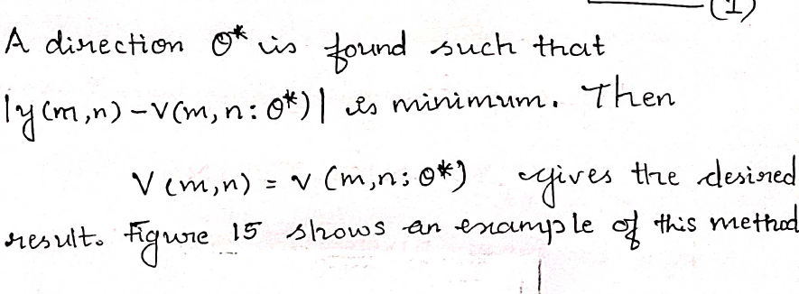

Slide 49
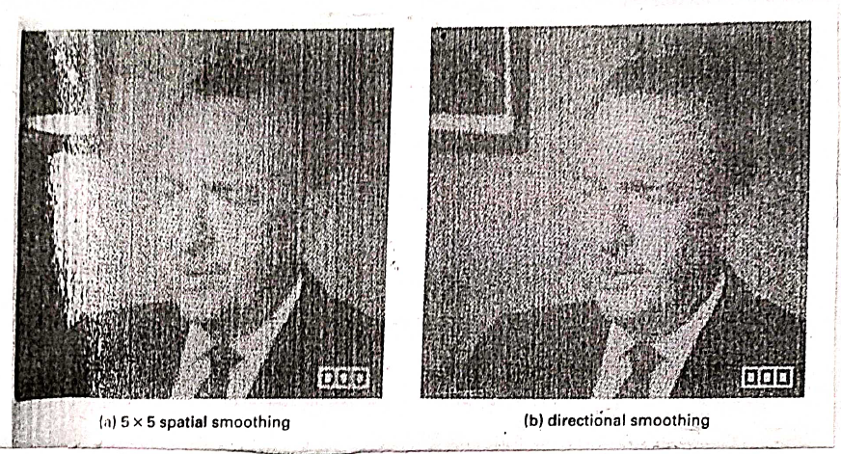

Slide 50
Median Filtering
Median filtering is a non-linear spatial filtering technique used to remove impulse noise (salt and pepper noise) from images.
It replaces each pixel value with the median of the neighbouring pixel values within a filter window.

Slide 51
Steps
Choose a window (e.g., 3×3).
Arrange the pixel values inside the window in ascending order.
Find the median value.
Replace the centre pixel with the median.

Slide 52
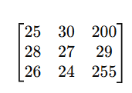
Apply a 3×3 median filter to the given image and find the new value of the centre pixel.
Given 3×3 window
Arrange pixel values in ascending order
All values inside the window:
25, 30, 200, 28, 27, 29, 26, 24, 255
Sorted:
24, 25, 26, 27, 28, 29, 30, 200, 255
Find the median
Since there are 9 values, the median is the 5th value.
Median = 28

Slide 53
Replace centre pixel
Original centre pixel = 27
After median filtering:
New centre pixel = 28

Slide 54
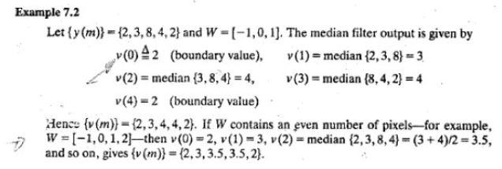

Slide 55
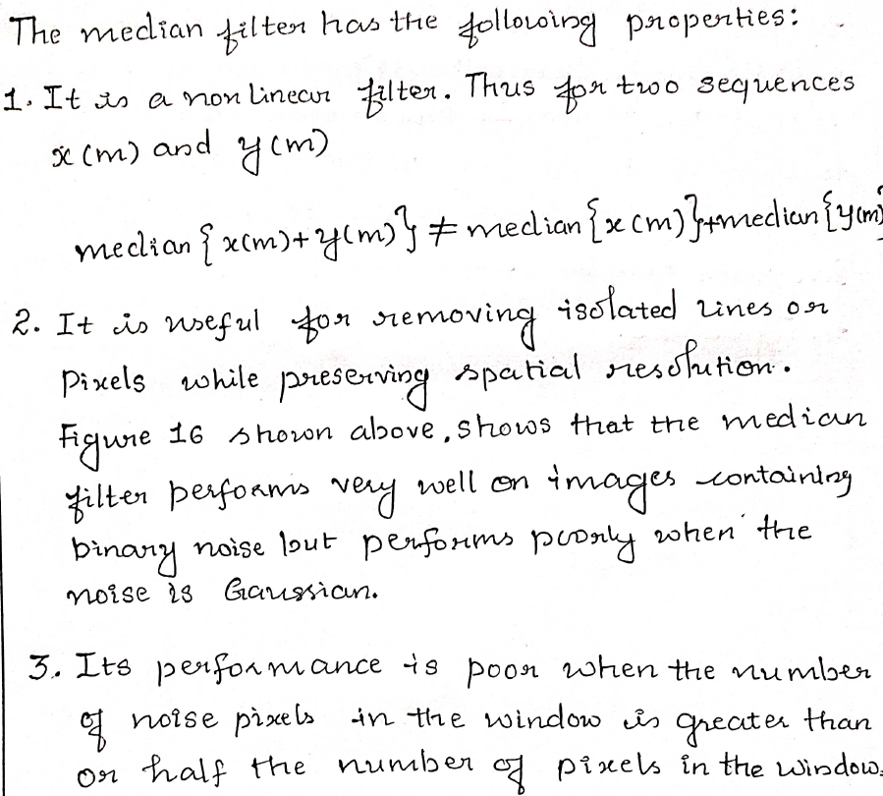

Slide 56
Unsharp Masking
Unsharp masking is a sharpening technique used to enhance edges and fine details in an image.
It subtracts a blurred version of the image from the original image.

Slide 57
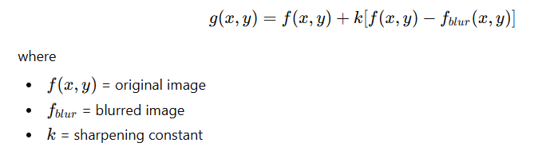
Steps
Blur the original image using a low-pass filter.
Subtract the blurred image from the original:
Mask = Original – Blurred
Add the mask to the original image:
Sharpened image = Original + Mask

Slide 58
Advantages
Enhances edges
Improves contrast
Simple and widely used

Slide 59
Crispening
Crispening is a technique used to enhance the contrast of specific intensity ranges while suppressing others.
It sharpens only selected gray levels, especially near edges or object boundaries.
Features
Highlights important structures
Reduces background noise
Improves visibility of fine details

Slide 60
Feature | Median Filtering | Unsharp Masking | Crispening
Type | Non-linear | Linear sharpening | Selective sharpening
Purpose | Noise removal | Edge enhancement | Contrast improvement
Noise removal | Yes | No | Limited
Edge preservation | Good | Good | Very good
Applications | Salt & pepper noise | Image sharpening | Medical images

Slide 61
Homomorphic filters
Homomorphic filtering is a frequency domain technique used to simultaneously normalize brightness and enhance contrast in an image.
It is mainly used to:
Reduce non-uniform illumination
Enhance reflectance details (edges & textures)

Slide 62
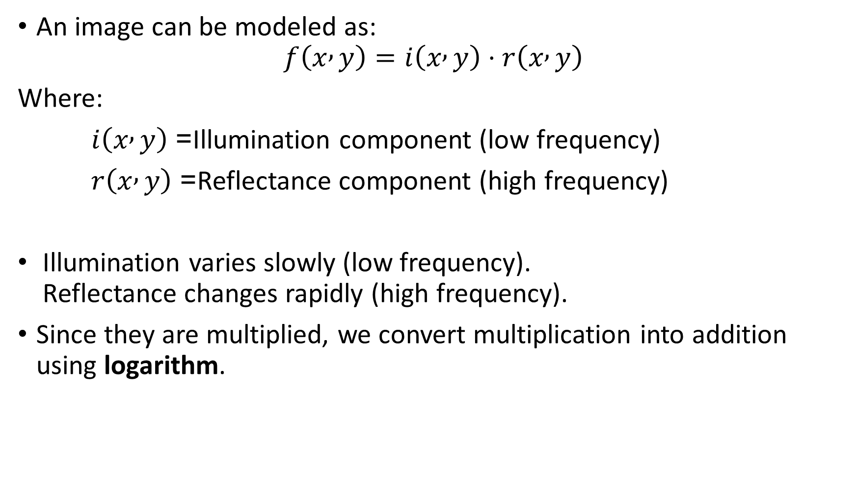
An image can be modeled as:
$$f\left(x , y\right)=i\left(x , y\right)⋅r\left(x , y\right)$$
Where:
$i\left(x , y\right)$= Illumination component (low frequency)
$r\left(x , y\right)$= Reflectance component (high frequency)
Illumination varies slowly (low frequency). Reflectance changes rapidly (high frequency).
Since they are multiplied, we convert multiplication into addition using logarithm.

Slide 63
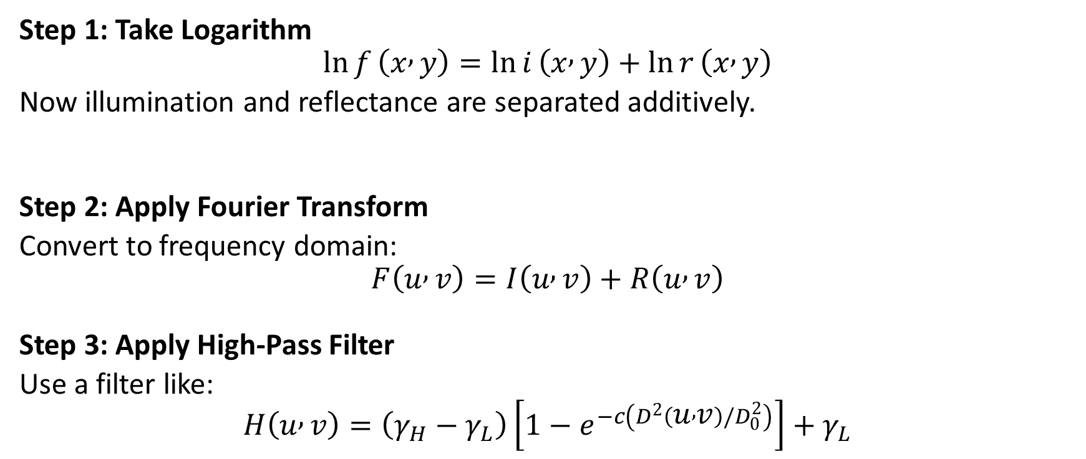
Steps in Homomorphic Filtering
Step 1: Take Logarithm
$$\ln{f}\left(x , y\right)=\ln{i}\left(x , y\right)+\ln{r}\left(x , y\right)$$
Now illumination and reflectance are separated additively.
Step 2: Apply Fourier Transform
Convert to frequency domain:
$$F\left(u , v\right)=I\left(u , v\right)+R\left(u , v\right)$$
Step 3: Apply High-Pass Filter
Use a filter like:
$$H\left(u , v\right)=\left(γ_{H}−γ_{L}\right)\left[1−e^{−c\left(D^{2}\left(u , v\right)/D_{0}^{2}\right)}\right]+γ_{L}$$

Slide 64
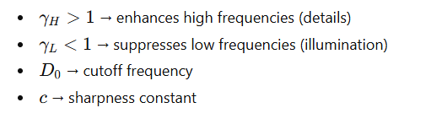
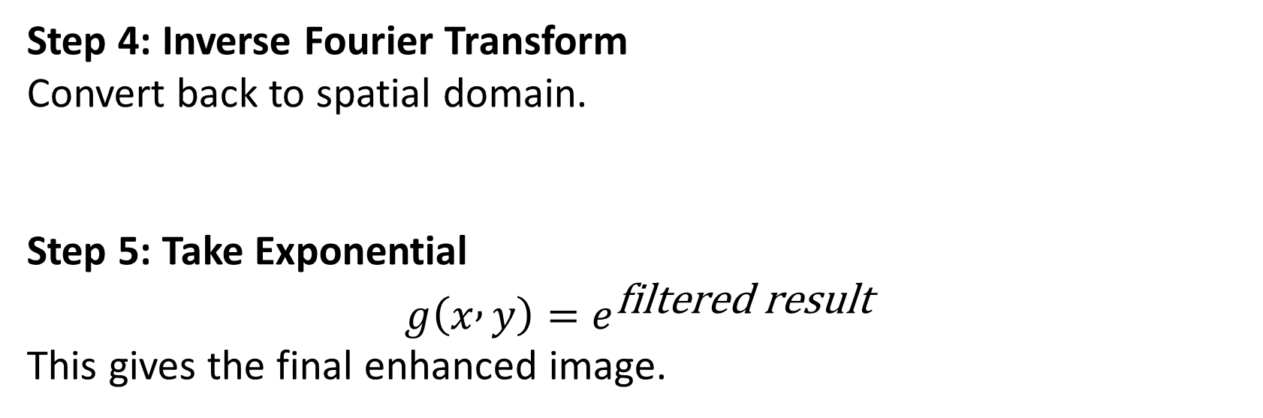
Step 4: Inverse Fourier Transform
Convert back to spatial domain.
Step 5: Take Exponential
$$g\left(x , y\right)=e^{\text{filtered} \text{result}}$$
This gives the final enhanced image.

Slide 65
The filter used is a modified high-pass filter:
Suppresses low frequencies (reduces uneven lighting → smoothing effect)
Amplifies high frequencies (enhances edges → sharpening effect)

